Slide 1
Federal Practice Finding the Ripcords
October 15, 2019 – Southern District of California
@JWagstaffeLxNx

Slide 2
Resources
FRCP &
Title 28
The Wagstaffe Group Practice Guide: Fed. Civ. Pro. Before Trial (LexisNexis 2019)
PowerPoint Slides

Slide 3
State Claim in Federal Court
State Substance
Federal Procedure
Erie Railroad v. Tompkins

Slide 4
Procedural Differences
Jurisdiction
Pleadings
Venue
Judges
Juries
Summary Judgment
Discovery

Slide 5
Substance
Procedure

Slide 6
State “Reform” Examples
Damage Caps
Bifurcate Punitive Damages
Certificates of Merit
Pre-Lawsuit Notices

Slide 7
State Anti-SLAPP Statues Apply in Federal Court?
YES
NO
Klocke v. Watson (5th Cir. 8/29/19); Abbas v. Foreign Policy Group (D.C. Cir. 2015) 783 F.3d 1328; Carbone v. CNN (11th Cir. 2018) 910 F.3d 1345; Los Lobos Renewable Power v. Americulture, (10th Cir. 2018) 885 F.3d 659
Planned Parenthood v. Center for Med. Progress (9th Cir. 2018); Godin v. Schencks (1st Cir. 2010) 629 F.3d 79

Slide 8
State Procedure Serving Specific Substantive Goal
Intention to influence substantive outcome manifest
Goal defeated if not applied in federal diversity suit

Slide 9
LINGO
FEDERAL
Claim for Relief
Counter/Cross Claim
No Does
Motion to Dismiss
CALIFORNIA
Cause of Action
Cross-Complaint
Doe Defendants
Demurrer

Slide 10
Merits
Attack
Personal Jx
Venue
Subject Matter Jx

Slide 11
Four Doorways to Federal Court
Front
Door
Back Door
Side Door
Visitors’ Door

Slide 12
FRONT DOOR
Arising Under
Federal Defense -- Not

Slide 13
Quotation
“I like to ask people for directions in my own neighborhood and then I grade them.”
- Stephen Wright

Slide 14
Minton loses federal patent suit
Minton sues attorney Gunn for malpractice
Question: Motion to Dismiss for lack of Subject Matter Jurisdiction?

Slide 15
Grant
See Gunn v. Minton 568 U.S. 251 (2013)
Malpractice claim does not “arise under” federal law
See Palkow v. CSX Transp. (6th Cir. 2005) 431 F.3d 543—no federal jurisdiction over state “perjury” statute

Slide 16
Arising Under Jurisdiction
Suit against Bayer for damages from female sterilization device
Removed as “substantial federal question” since device regulated by FDA subject to federal Medical Device Act (21 U.S.C. § 360(c))
Motion to remand for lack of jurisdiction?

Slide 17
Grant
Burrell v. Bayer Corp. (4th Cir. 2019) 918 F.3d 372
No private right of action under federal statute and preemption only defensive
No Grable “substantial federal question”
See also Miller v. Yellow Pages (S..D. Cal. May 23, 2018) (Hayes, J.)--no removal of California Rosenthal Fair Debt Collection Practices Act (Cal. Civ. Code § 1788) simply because complaint makes reference to FDCPA (15 U.S.C. § 1692) and could have been brought under federal law

Slide 18
VISITOR’S DOOR
Complete Diversity
Citizenship Rules
Amount in Controversy

Slide 19
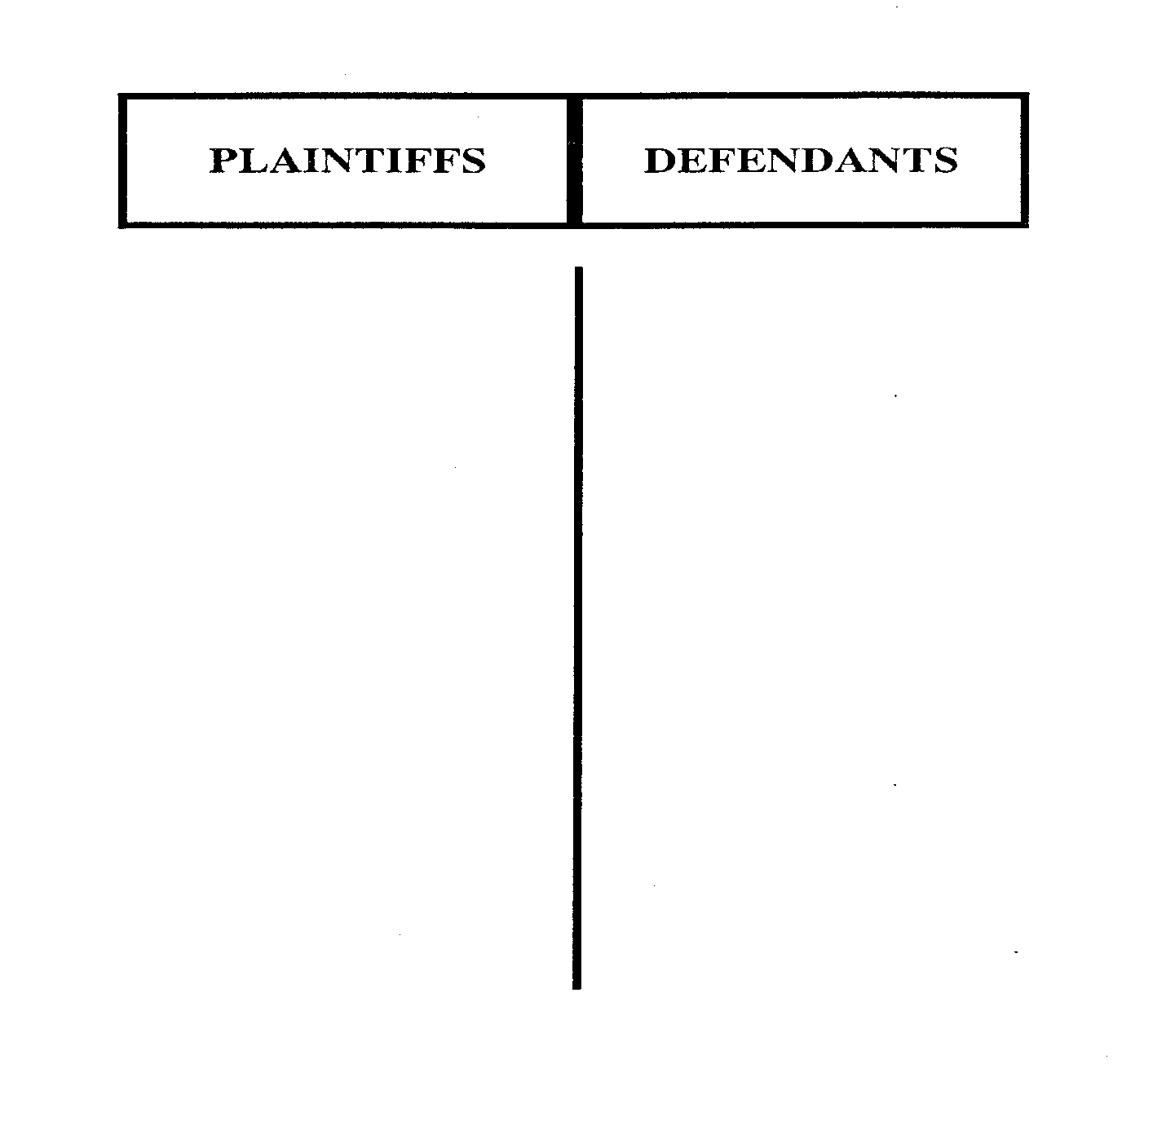
Filling Out the Line-up Card
NY
If Same state on Both Sides

Slide 20
Complete Diversity
If Same state on Both Sides
P-1 (CA) D-1 (NY)
P-2 (CA) D-2 (OH)
28 U.S.C. Sec. 1441(a)

Slide 21
Citizenship Rules
Individuals
Corporations
Other Entities
If Same state on Both Sides

Slide 22
Individuals
Physical Presence in New Location
Intent to Remain Indefinitely
Change of Domicile
If Same state on Both Sides

Slide 23
FACTS TO CONSIDER
Residences
Assets
Location
State-Issued
Licenses
Family,
Mail &
Community
Representations
In Public Documents
Property
Ownership
Voter
Registration
Tax Returns
Employment

Slide 24
Corporations
All States of Incorp.
Principal Place of Business
Corp.’s Citizenship
If Same state on Both Sides

Slide 25
Non-Corporate Entities
Citizenship
Of All Members
Purchasing Power, LLC v. Bluestem Brands, Inc. (11th Cir. 2017) 851 F.3d 1218

Slide 26
Diversity Drawing
D – You Light ‘Em LLC
Anello (FL)
Wagstaffe (FL)
PLAINTIFF DEFENDANT
Huff (CA)

Slide 27
Diversity Drawing – Change Facts
D – You Light ‘Em LLC
Anello LLP (FL)
George Anello (CA)
Wagstaffe (FL)
Mary Anello (CA)
PLAINTIFF DEFENDANT
Huff (CA)

Slide 28
BACK DOOR
Removal = Original Jurisdiction (Diversity & Federal Question)
Squeaky Procedures

Slide 29
Removal Jurisdiction
Diversity
Complete
Delete Keys
A-I-C
Local Defendant Bar

Slide 30
Removal – Complete Diversity
If Same state on Both Sides
P-1 (CA) D-1 (NY)
P-2 (CA) D-2 (OH)
28 U.S.C. Sec. 1441(a)

Slide 31
Local Defendant – Removal Bar
If Same state on Both Sides
P-1 (VA) D-1 (NY)
P-2 (VA) D-2 (CA)
28 U.S.C. Sec. 1441(b)(2)

Slide 32
Sham Joinder – Delete Key
If Same state on Both Sides
P-1 (CA) D-1 (NY)
P-2 (CA) D-2 (CA)
28 U.S.C. Sec. 1441; Grancare, LLC v. Thrower (9th Cir. 2018) 889 F.3d 543; Ramirez v. Home Depot (SD CA 2018) (Bericivengo, J.)

Slide 33
Removal Diversity Jurisdiction
Action by LLC against Rhode Island D is removed to federal court with jurisdictional allegation: “P is a Delaware LLC with its principal place of business in New York”
Removal notices also states that “P has no members who are citizens of Rhode Island”
How should the court rule on the motion to remand?

Slide 34
Grant
Yes, if, in fact, no diversity jurisdiction
Are diversity allegations in notice of removal inadequate?
D.B. Zwirn Special Opportunities Fund v. Mehrota (1st Cir. 2011) 661 F.3d 124; Ehrman v. Cox Communications, Inc. (9th Cir. August 8, 2019)—removing defendant’s allegations of citizenship in CAFA case on information and belief satisfactory unless factually challenged; Dancel v. Groupon (7th Cir. 10/9/19)—CAFA removal not satisfied by “negative citizenship” allegation that some plaintiffs “undoubtedly” diverse

Slide 35
Amount in Controversy – On Removal:
28 U.S.C. § 1446 (b)(2)A)
Assume state court silent on amount in controversy.
Defendant removes the action to federal court and in the notice states generally: “The amount in controversy exceeds 75,000.”
How should the court rule on the motion to remand?

Slide 36
Hold Hearing
Court should accept defendant’s statement of jurisdiction on removal when not contested by the plaintiff or questioned by the Court. But if so, consider evidence and make findings.
Dart Cherokee Basin Operating Co. v. Owens (2014) 135 S.Ct. 547; Dudley v. Eli Lilly and Co. (11th Cir. 2014) 778 F.3d 909; Allied v. Frito Lay (SD CA 2018) (Sammartino, J.)

Slide 37
Burden of Proof - Jurisdiction
Burden on party invoking federal jurisdiction
In diversity, party with burden must allege and prove sufficient facts for citizenship
See, e.g. Midcap Media Finance, L.L.C. v. Pathway Data, Inc.(5th Cir. 2019) – individuals: must prove domicile not “residence”; corporations: must prove state(s) of incorporation and PPB; and LLC’s: must prove citizenship of all its members

Slide 38
Removal Jurisdiction
Federal
Question
Arising Under
Defensive Preemption
Complete
Preemption
Grable

Slide 39
Removable to Federal Court?
Predicate Act Required
State “Little RICO” Claim
Federal Mail & Wire Fraud
Patterman v. Travelers (ND GA 1997) 11 F.Supp.2d 1382

Slide 40
Removal Jurisdiction
“Lack of standing to foreclose” claim under state law barring due on sale clauses
Removed under Federal Garn-St. Germain Act (12 U.S.C. § 1701j-3) – referenced in complaint
Motion to remand for lack of jurisdiction?

Slide 41
Grant
Estate of Cornell v. Bayview Loan Servicing, LLC (6th Cir. 2018) 908 F.3d 1008
No private right of action under federal statute
No Grable “substantial federal question”
See also See also WNT,Inc. v. Awojuola (S..D. Cal. August 7,2019) (Houston, J.)--no removal of unlawful detainer action removed under Fed. Protecting Tenants At Foreclosure Act (12 U.S.C. § 5201) since no private right of action and not substantial federal question under Grable; Moriah Properties, LLC v. Stoutenburg (S.D. Cal. 10/31/18) (Battaglia, J.)--same

Slide 42
Remand Checklist
REMAND FRIDAY OSC’s
Test Diversity Allegations
Untimely Removal
Waiver
Served Local Defendant
Make Sure Shams are Sham
All D’s Did Not Join
Distrust “Substantial Federal Q” and Complete Preemption

Slide 43
SIDE DOOR
Same Transaction or Occurrence
Supplemental Parties

Slide 44
Holding: Not “Same Transaction or Occurrence”
Soliday v. Miami County, Ohio (6th Cir. 1995) 55 F.3d 1158, 1165
Deliberate Indifference
Wrongful Death
Mistaken Cremation
Coroner Handles Body

Slide 45
Decline Suppl. Jx.?
Novel or Complex
Subst. Predomin.
Federal Claim Dismissed
Other Compelling Reason

Slide 46
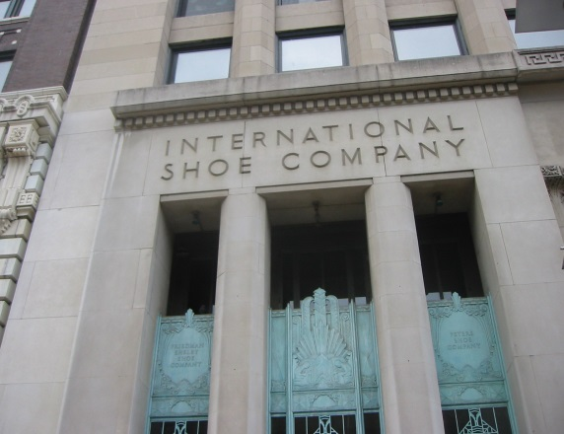
International Shoe & Modern Formulation
Due Process requires Defendant have certain minimum contacts with forum state such that maintenance of suit does not offend traditional notions of fair play and substantial justice

Slide 47
INTENTIONAL TORTS
Intentional Act
Expressly Aimed at Forum
D Knows Likely
Cause Harm in Forum

Slide 48
Knowing Effect: Walden v. Fiore (2014) 134 S.Ct. 1115
DEA Agent at Airport in Georgia
Illegally Seizes Gambling Winnings of Nevada-Bound Plaintiffs
Plaintiffs Fly On to Nevada and Send Substantiating Proof to Atlanta
DEA Agent Filed False Affidavit To Facilitate Forfeiture of Cash to Government
Plaintiffs allege injury in Nevada where they, in part, reside

Slide 49
Walden World
D + CAUSE OF ACTION + FORUM = JX
NOT SIMPLY BECAUSE P RESIDES IN FORUM
D’s MEANINGFUL CONNECTIONS TO FORUM
Content

Slide 50
Don’t Count the π
U .S. Bank Nat’l Ass’n v. Bank of America N.A. (2d Cir. 2/15/19) __F.3d __ --”pertinent question is whether the defendant has links to the jurisdiction in which the suit was filed, not whether the plaintiff has such links”
Ariel Investments v. Ariel Capital Advisors imply because P in forum state(7th Cir. 2018) 861 F.3d 520—no personal jurisdiction in trademark suit simply because plaintiff in forum state
LP Solutions LLC v. Duchosois (1st Cir. 2018) 907 F.3d 95, 102)—merely sending contract payments on occasion to forum not sufficient for purposeful availment
Parker v. Winwood (6th Cir. 9/17/19) 2019 U.S. App. LEXIS 2790218 F.3d 193—no personal jurisdiction in copyright suit simply because plaintiff resides in forum state

Slide 51
Bristol-Meyers Squibb v. Sup. Ct. 137 S.Ct. 1773 (2017)
California – 86 P’s Elsewhere – 592 P’s
Substantial operations:
5 offices,414 employees
187 million pills; $918 million in revenue
California Distributor
R&D and 50% of employees in New York & New Jersey
98% of sales revenue outside California
Ads & Mktg. – East Coast

Slide 52
No general jurisdiction since D is not at home or served in forum
No Personal Jurisdiction over Bristol Meyers
Specific Jx lacking regardless of extent of D’s unconnected state activities

Slide 53
MTD (Rule 12(b)(2))
No Evidentiary Hearing
P -- Prove Only Prima Facie Case
Allegations Accepted as True
Evidentiary Hearing
P – Prove By Preponderance of Evidence

Slide 54
VENUE – 1391(b)
(1) Residence of any defendant if all defendants reside in same state
(2) District in which substantial part of events or omissions occurred
(3) Fallback venue, i.e., if no district in which venue is proper, any district in which any defendant is subject to personal jurisdiction

Slide 55
Plaintiff Defendants
Nevada
Los Angeles
San Francisco
San Diego

Slide 56
Fallback Venue
No District Otherwise Brought
Foreign Events
Where Any D Subject to P Jx

Slide 57
Compare – Removal Venue (28 USC §§ 1390(c), 1441(a))
State Court
District Where Action Pending
Original Federal Venue Proper

Slide 58
“Letters of Transit”
Venue
Shift
§1404
§1406
FNC
§1407

Slide 59
PRIVATE INTEREST PUBLIC INTEREST
Access to Proof
Compulsory Process
View of Premises
Practical Trial Problems
Third Party Witnesses
Court Congestion
Local Court Interests
Familiarity with Governing Law
International Comity
Burden on Local Jurors

Slide 60
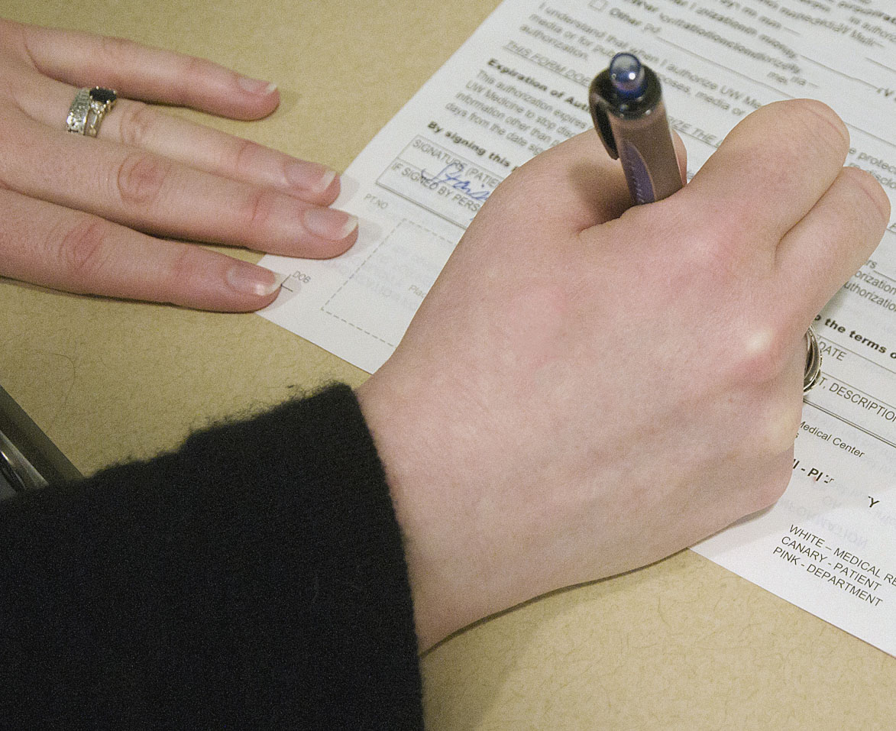
Impact of Forum Selection Clauses
Consent?

Slide 61
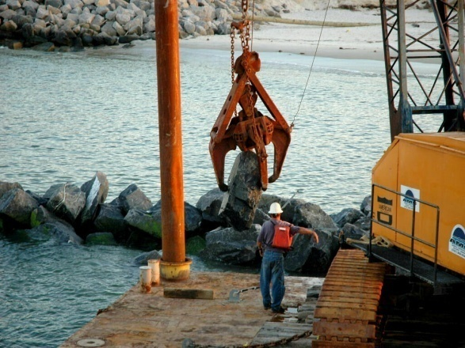
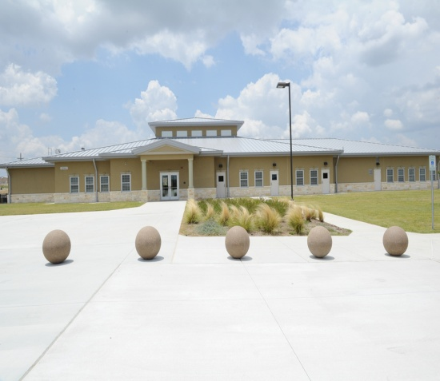
Atlantic Marine Case
Contracts with Army Corps of Engineers
Subcontracts with J-Crew Management (TX)
Ford Hood, Texas
Atlantic Marine Constr. Co. (VA)

Slide 62
Circuit Court City of Norfolk, Virginia
OR
U.S. Dist. Court E.D. Va.
Mandatory Forum Selection for All Disputes Between Parties

Slide 63
Impact of Atlantic Marine
Private Interests Irrelevant
No Deference to P’s Choice of Forum
Presumptive Enforcement
Law of Transferee Court

Slide 64
Enforce Not
Fraud
Contravene Strong Public Policy of Forum
Fundament. Unfair
No Notice

Slide 65
Impact of Atlantic Marine
Although contract provided venue shall be in Linn, County Oregon, D removed action to federal court
Linn County lies within District of Oregon, Eugene Division, but there is no federal courthouse in Linn County
Remand?
City sues out of state engineering company in Linn County Oregon state court for breach of contract

Slide 66
Remand
Content
Clear and unequivocal waiver of right to remove since no federal court “in” Linn County
City of Albany v. CH2M Hill, Inc. (9th Cir. 2019) 924 F.3d 1306; Bartels v. Saber Healthcare Group, LLC (4th Cir. 2018) 880 F.3d 668—same; Medtronic Sofamor Danek, Inc. v. Gannon, 913 F.3d 704 (8th Cir. 2019)—remand required per clause mandating litigation in state court; Grand View v. Helix Electric (5th Cir. 2017) 847 F.3d 255---same; Autoridad de Energia Electrica v. Vitol S.A, 859 F.3d 140 (1st Cir. 2017)—waiver for one defendant waives for all; TWG §8-VII[A][2

Slide 67
Twombly/Iqbal: Two-Step
T I - TWO STEP
Consider allegations showing plausible entitlement to relief
Ignore Conclusory Allegations

Slide 68
Show me facts why it’s not just a suspicion
E.g.
Disability Rights Montana, Inc. v. Batista (9th Cir. 2019) 930 F.3d 1090—sufficient allegations of horrific treatment of prisoners with mental illness by putting them in solitary confinement
Starr v. Baca (9th Cir. 2011) 652 F.3d 1216—sufficient allegations Sheriff acquiesced and encouraged deliberate indifference to plaintiff

Slide 69
Twombly/Iqbal - Conclusory
Conspiracy
Bad Faith
Color of Law
Malice
Retaliation

Slide 70
Twombly/Iqbal Hits – Plausible
Alter Ego
Qualified Immunity
Monell Policy
Multiple Defendants
Complex Claims

Slide 71
Practice Pointers
DEFENDANT
No Knee Jerk Motions
Bring Winners
Dispositive Defenses

Slide 72
Practice Pointers
PLAINTIFF
Be Not Afraid
Alternative Explanations
Request the Facts

Slide 73
SUMMARY JUDGMENT
Missing Element
Pure Question of Law
As a Whole Evidence Insufficient

Slide 74
Rule 12(b) Rule 56
Tests Legal Sufficiency
Presumes all well-pleaded facts
Leave to amend freely granted to clarify or add claims
Tests Factual Sufficiency
Examines non-moving party’s admissible proof
Motion directed to actual claims

Slide 75
DISCOVERY
Things Every Good Lawyer Must Know

Slide 76
Initial
Disclosure
26(a)(1)
Witnesses
Documents
Damage
Computation
Insurance

Slide 77
MEET & CONFER TOPICS
Production Format?
Metadata, use markers, sampling and proportionality?
Privilege Protocols?
Preservation Obligations?
Systems Info Exchange (and PMK Depo)?
Search Protocols?

Slide 78
MANAGING COSTS
Food
Stage Discovery
Narrow Timeframe
Eliminate Duplicates
Search by User

Slide 79
Wagstaffe Civ Pro Top 10
Erie RR v. Tompkins
Pennoyer v. Neff
Louisville & Nashville RR v. Mottley
United Mine Workers v. Gibbs
Atlantic Marine Constr. Co. v. U.S. Dist. Ct.
Celotex v. Catrett
Int’l Shoe v. Washington
Hickman v. Taylor
Twombly/Iqbal
Hansberry v. Lee

Slide 80
Wrapping Up
The Wagstaffe Group Practice Guide: Federal Civil Procedure Before Trial
Current Awareness
TheWagstaffeGroup.com
Follow me @JWagstaffeLxNx

